Slide 1
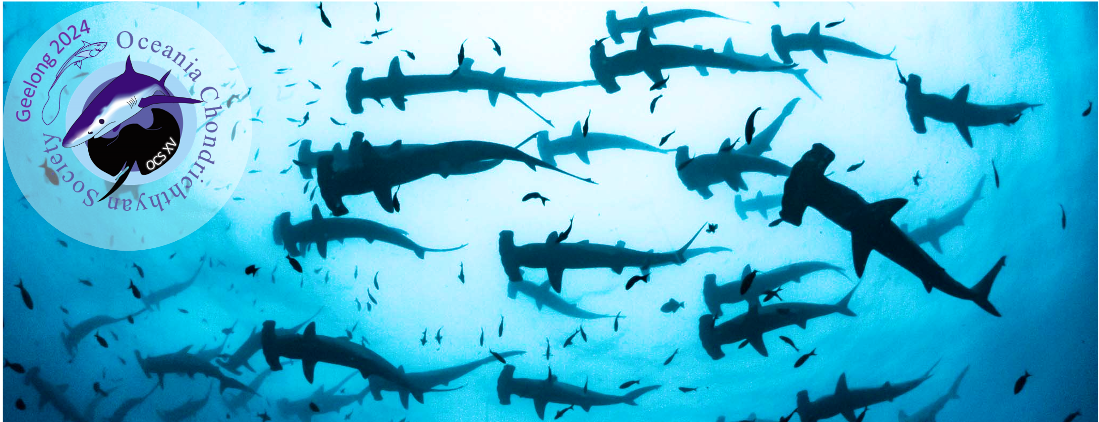
Using animal tracking data to explore behaviour and distributions of species

Slide 2
Housekeeping
Wifi connection
Toilets
Water station
Snacks/Tea/Coffee

Slide 3
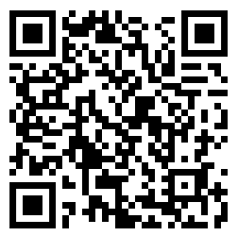
Program for today
Time | Session | Activity
08:00 – 08:30 | Introductions | Intros (IT troubleshooting if needed!)
08:30 – 10:00 | Session 1 | Basics of data cleaning and mapping using telemetry data
10:00 – 10:30 | Morning tea
10:30 – 12:00 | Session 2 | Using satellite telemetry data to define behaviours
12:00 – 13:00 | Lunch
13:00 – 14:30 | Session 3 | Basics of Species Distribution Models (SDMs)
14:30 – 15:00 | Afternoon tea
15:00 – 16:30 | Session 4 | Using telemetry data to define species distributions
16:30 – 17:00 | Workshop wrap-up
https://vinayudyawer.github.io/OCS2024_SDMworkshop/index.html

Slide 4
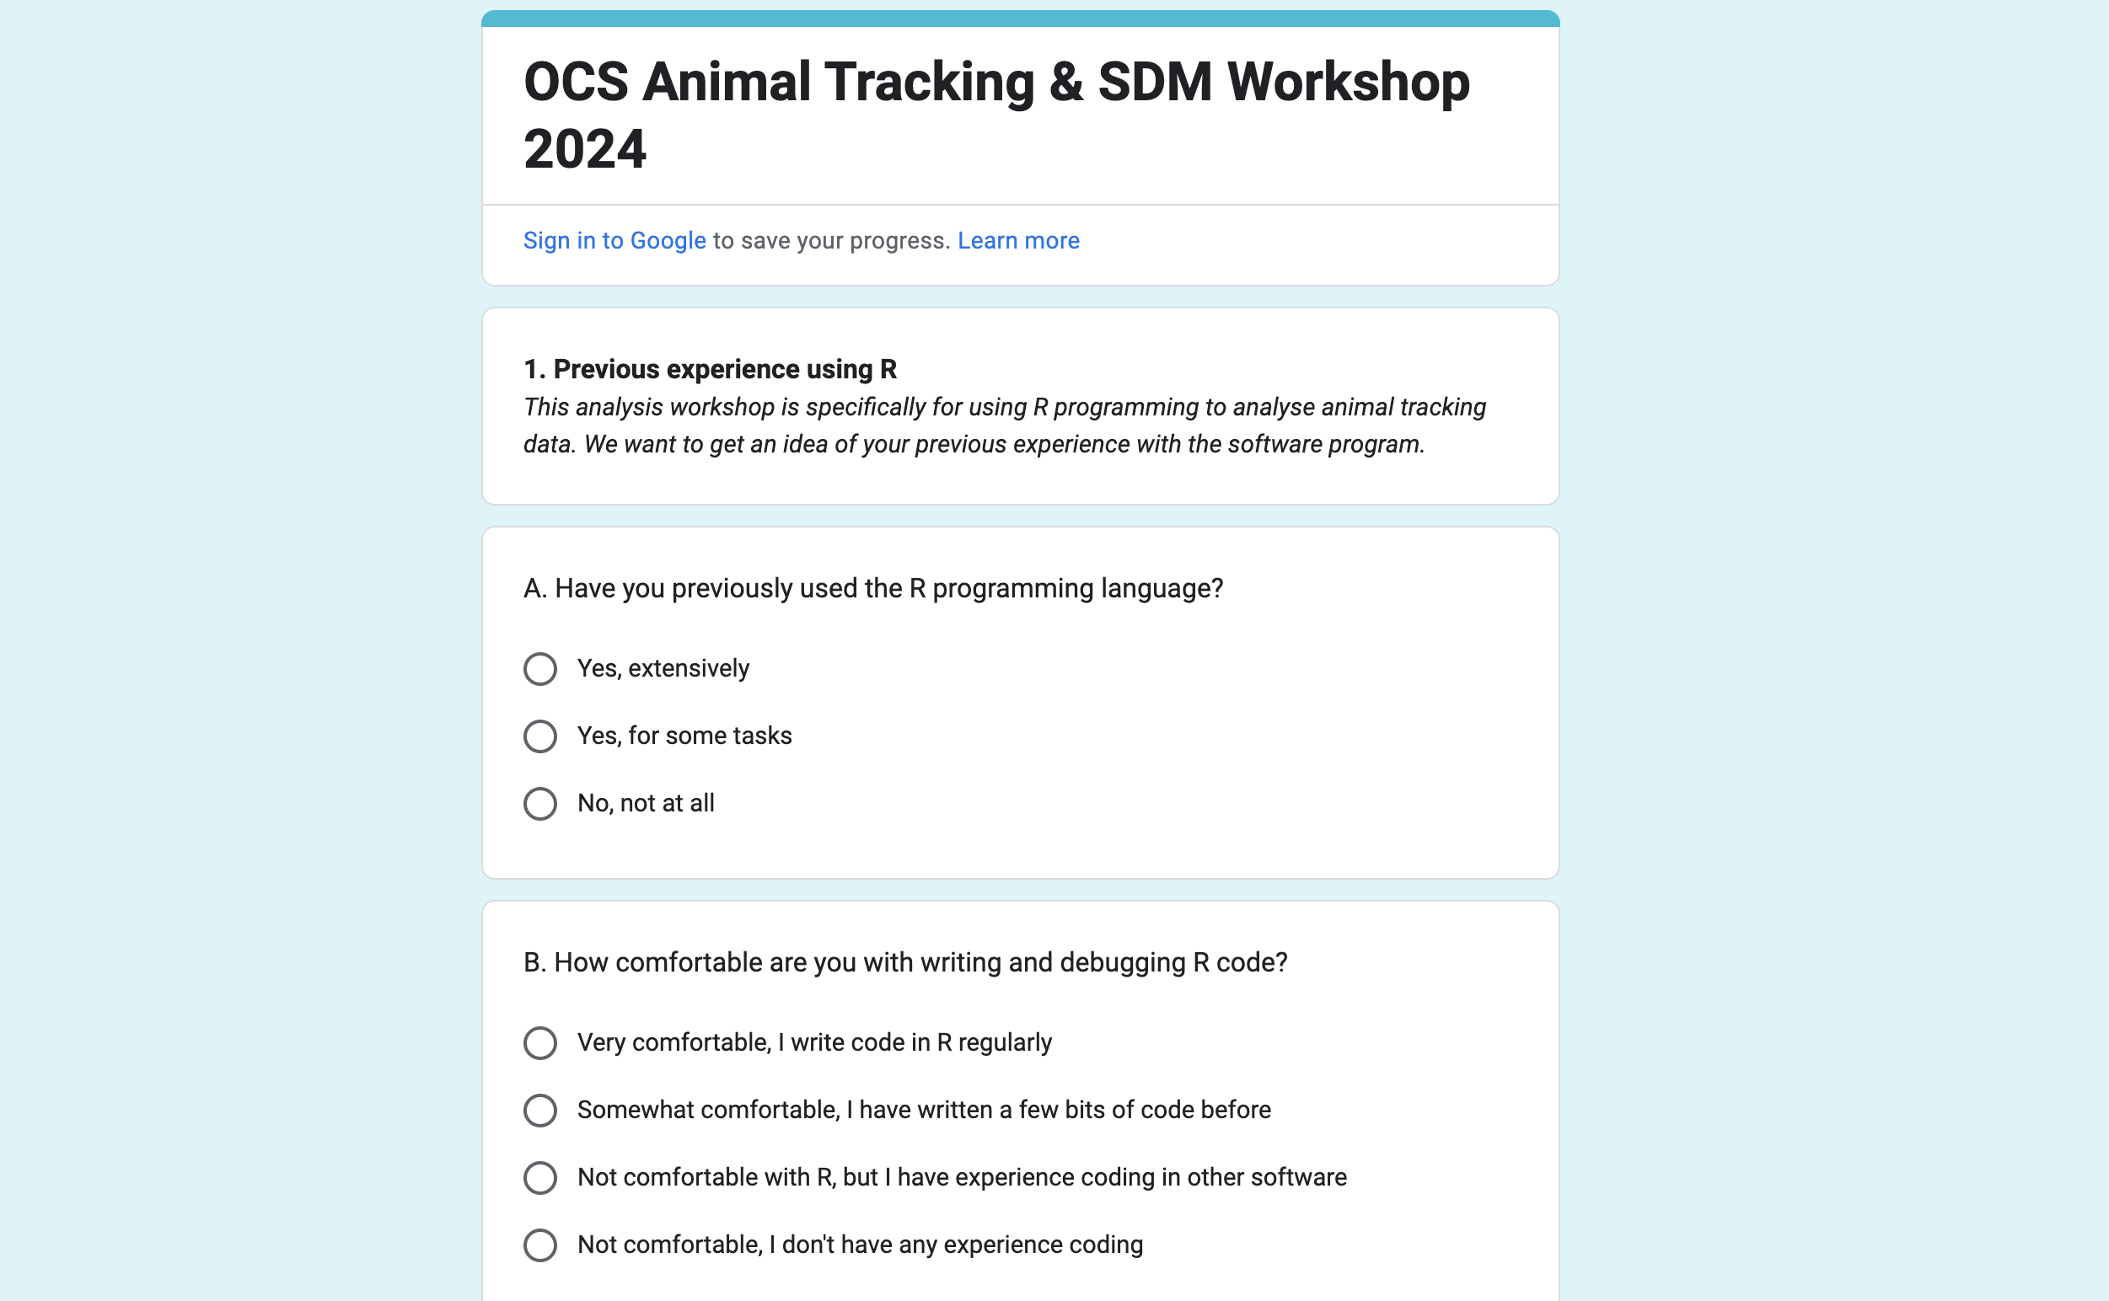
Survey Results

Slide 5
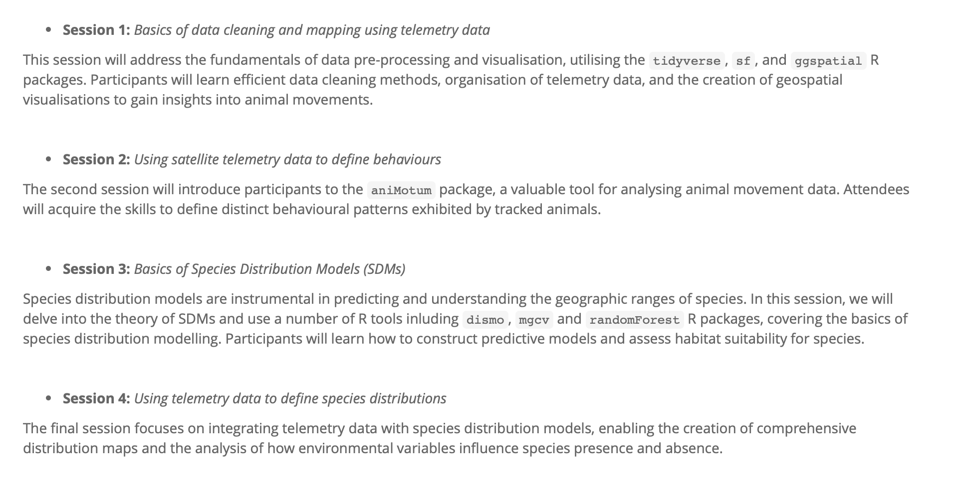
Session 1

Slide 6
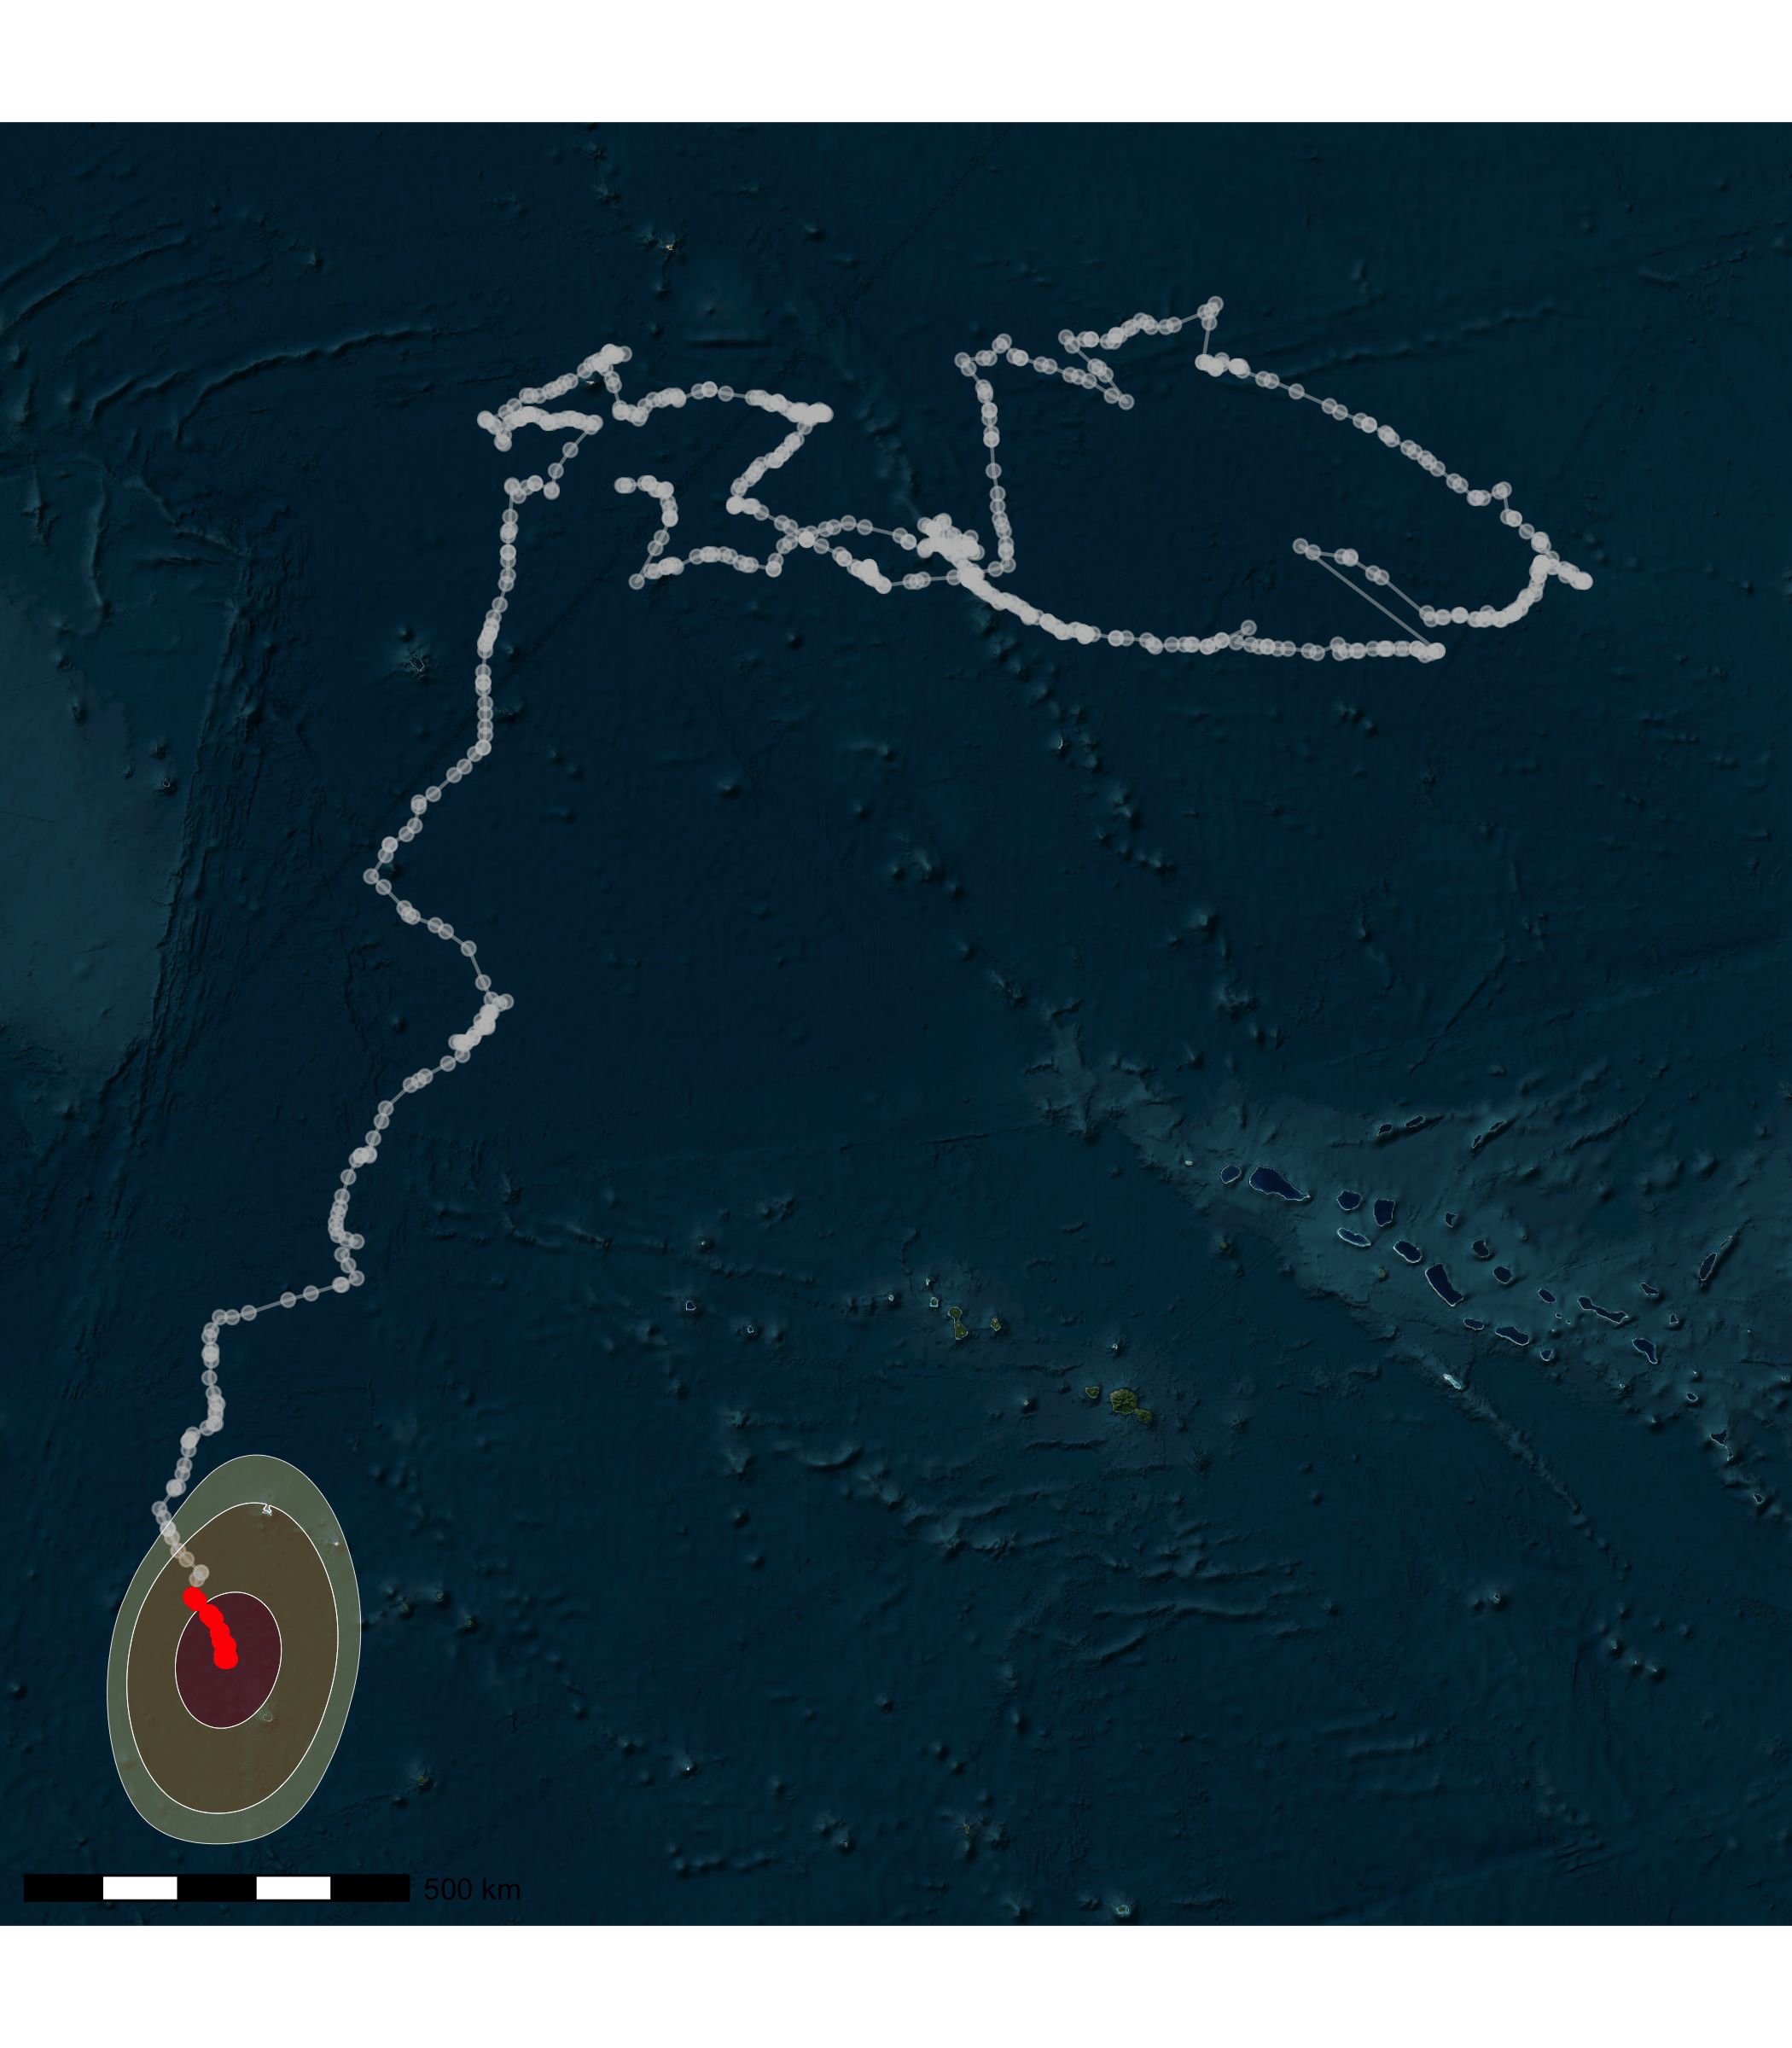
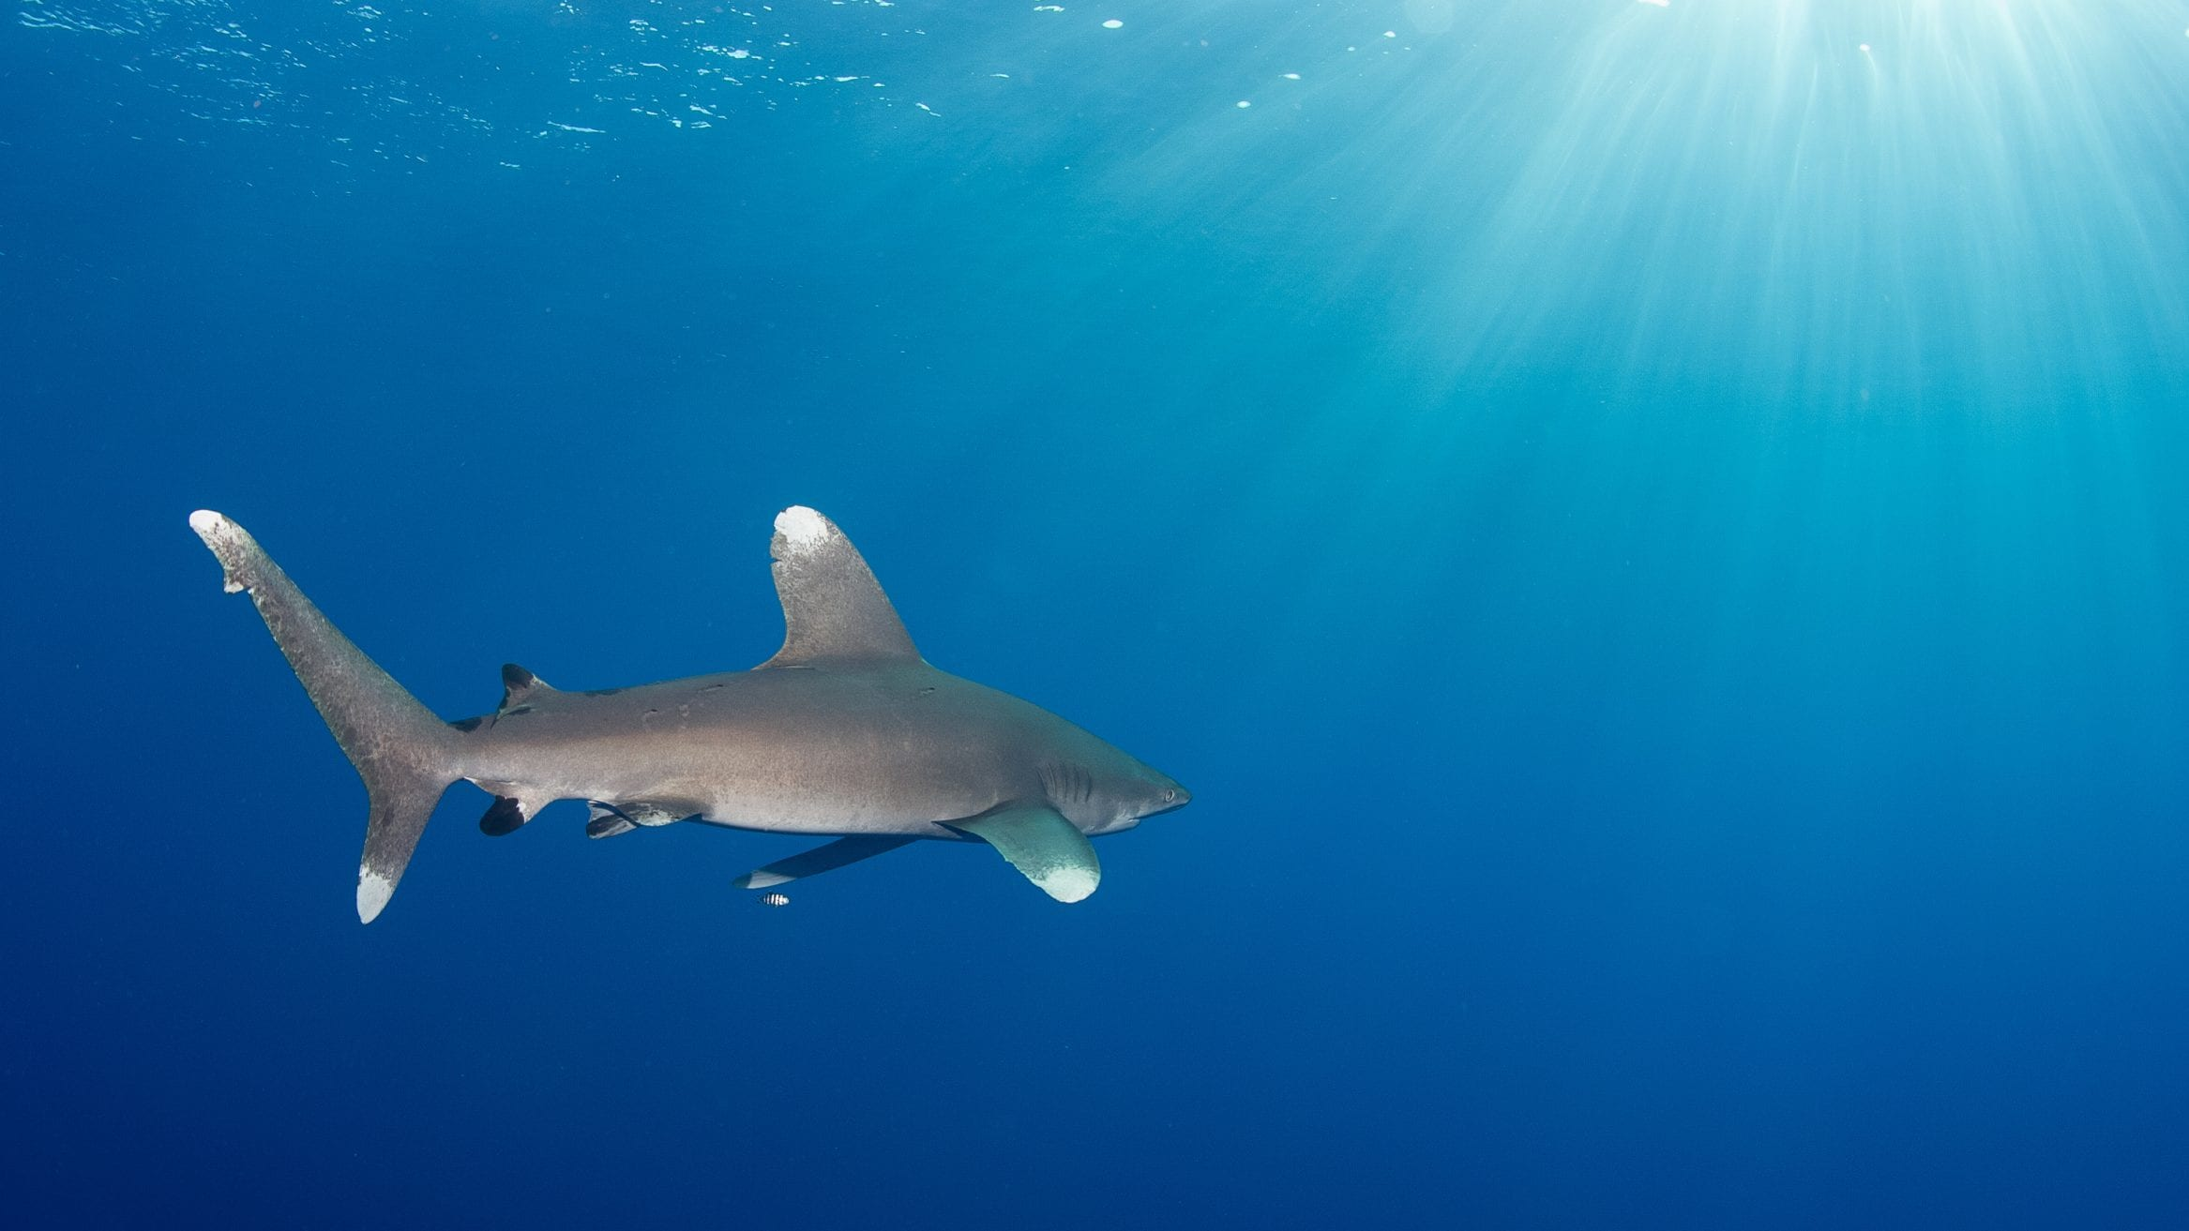
Session 1
You can then add more layers to build on the complexity of the animation
For example: adding Location error polygons

Slide 7
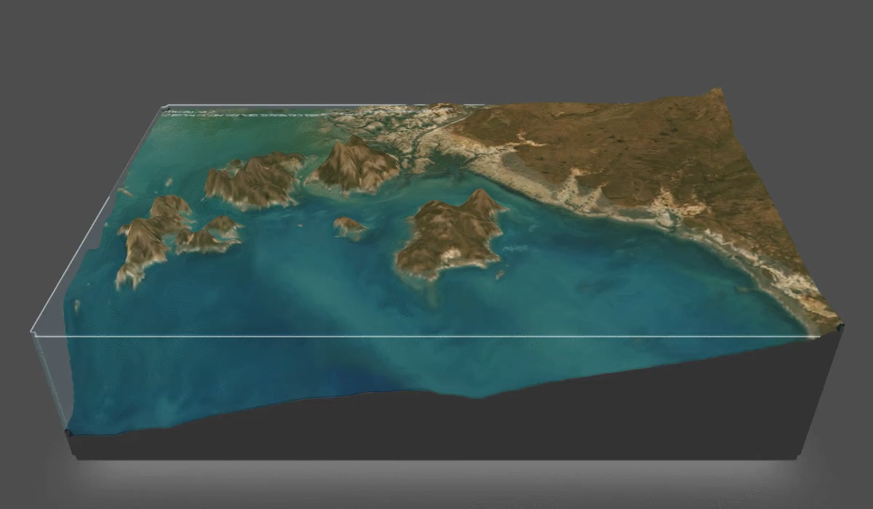
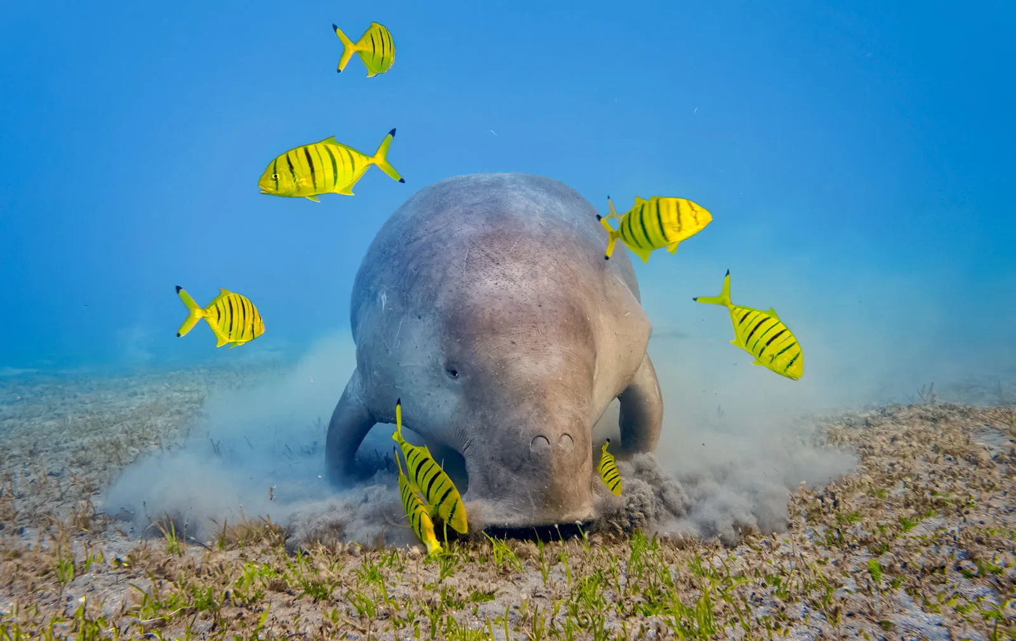
Session 1
Integrating Depth data to plot your tracks in 3D
`KUD3D` and `rayshader` packages

Slide 8
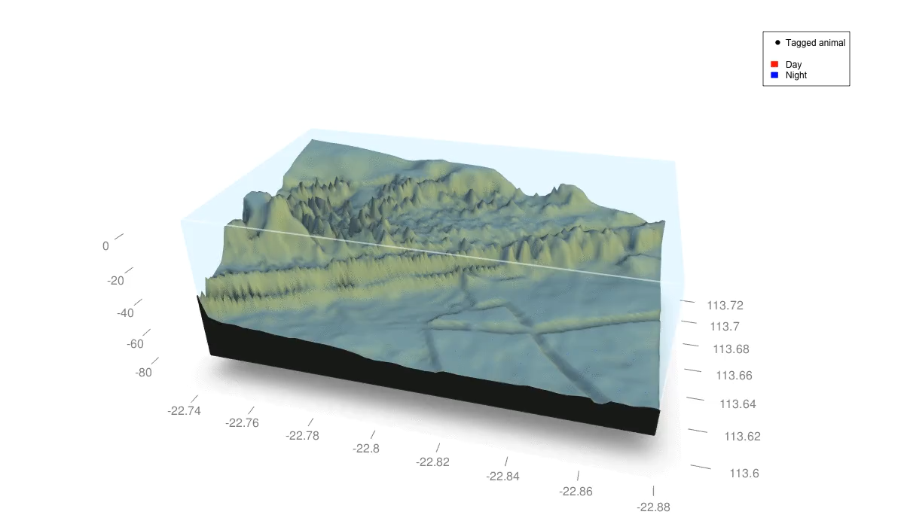
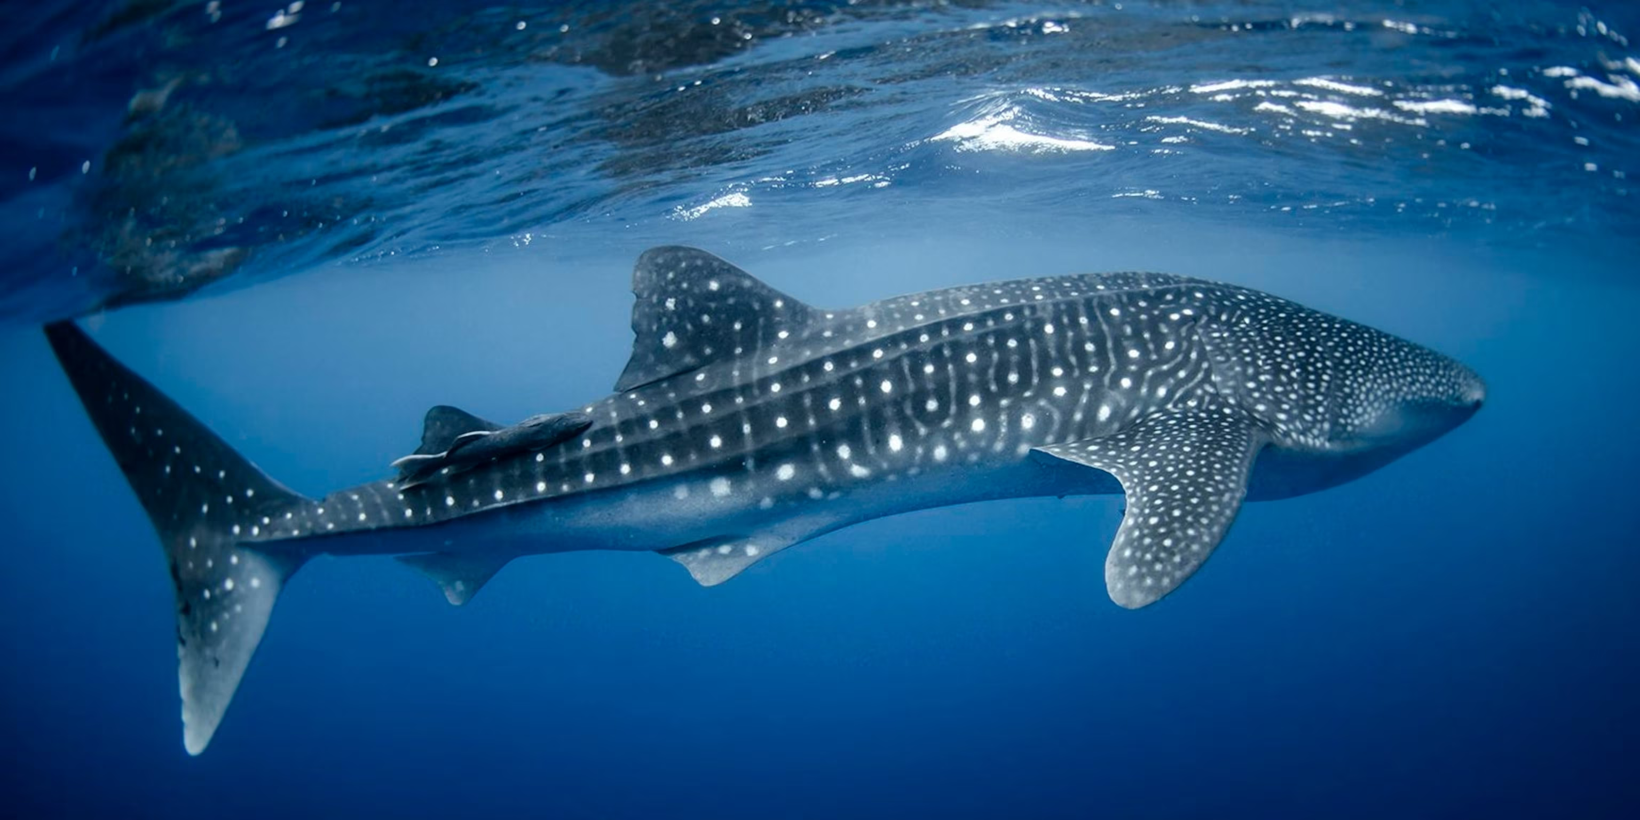
Session 1
Integrating Depth data to plot your tracks in 3D
`KUD3D` and `rayshader` packages
Calculate and visualise 3D activity spaces

Slide 9
Session 2

Slide 10
Session 3

Slide 11
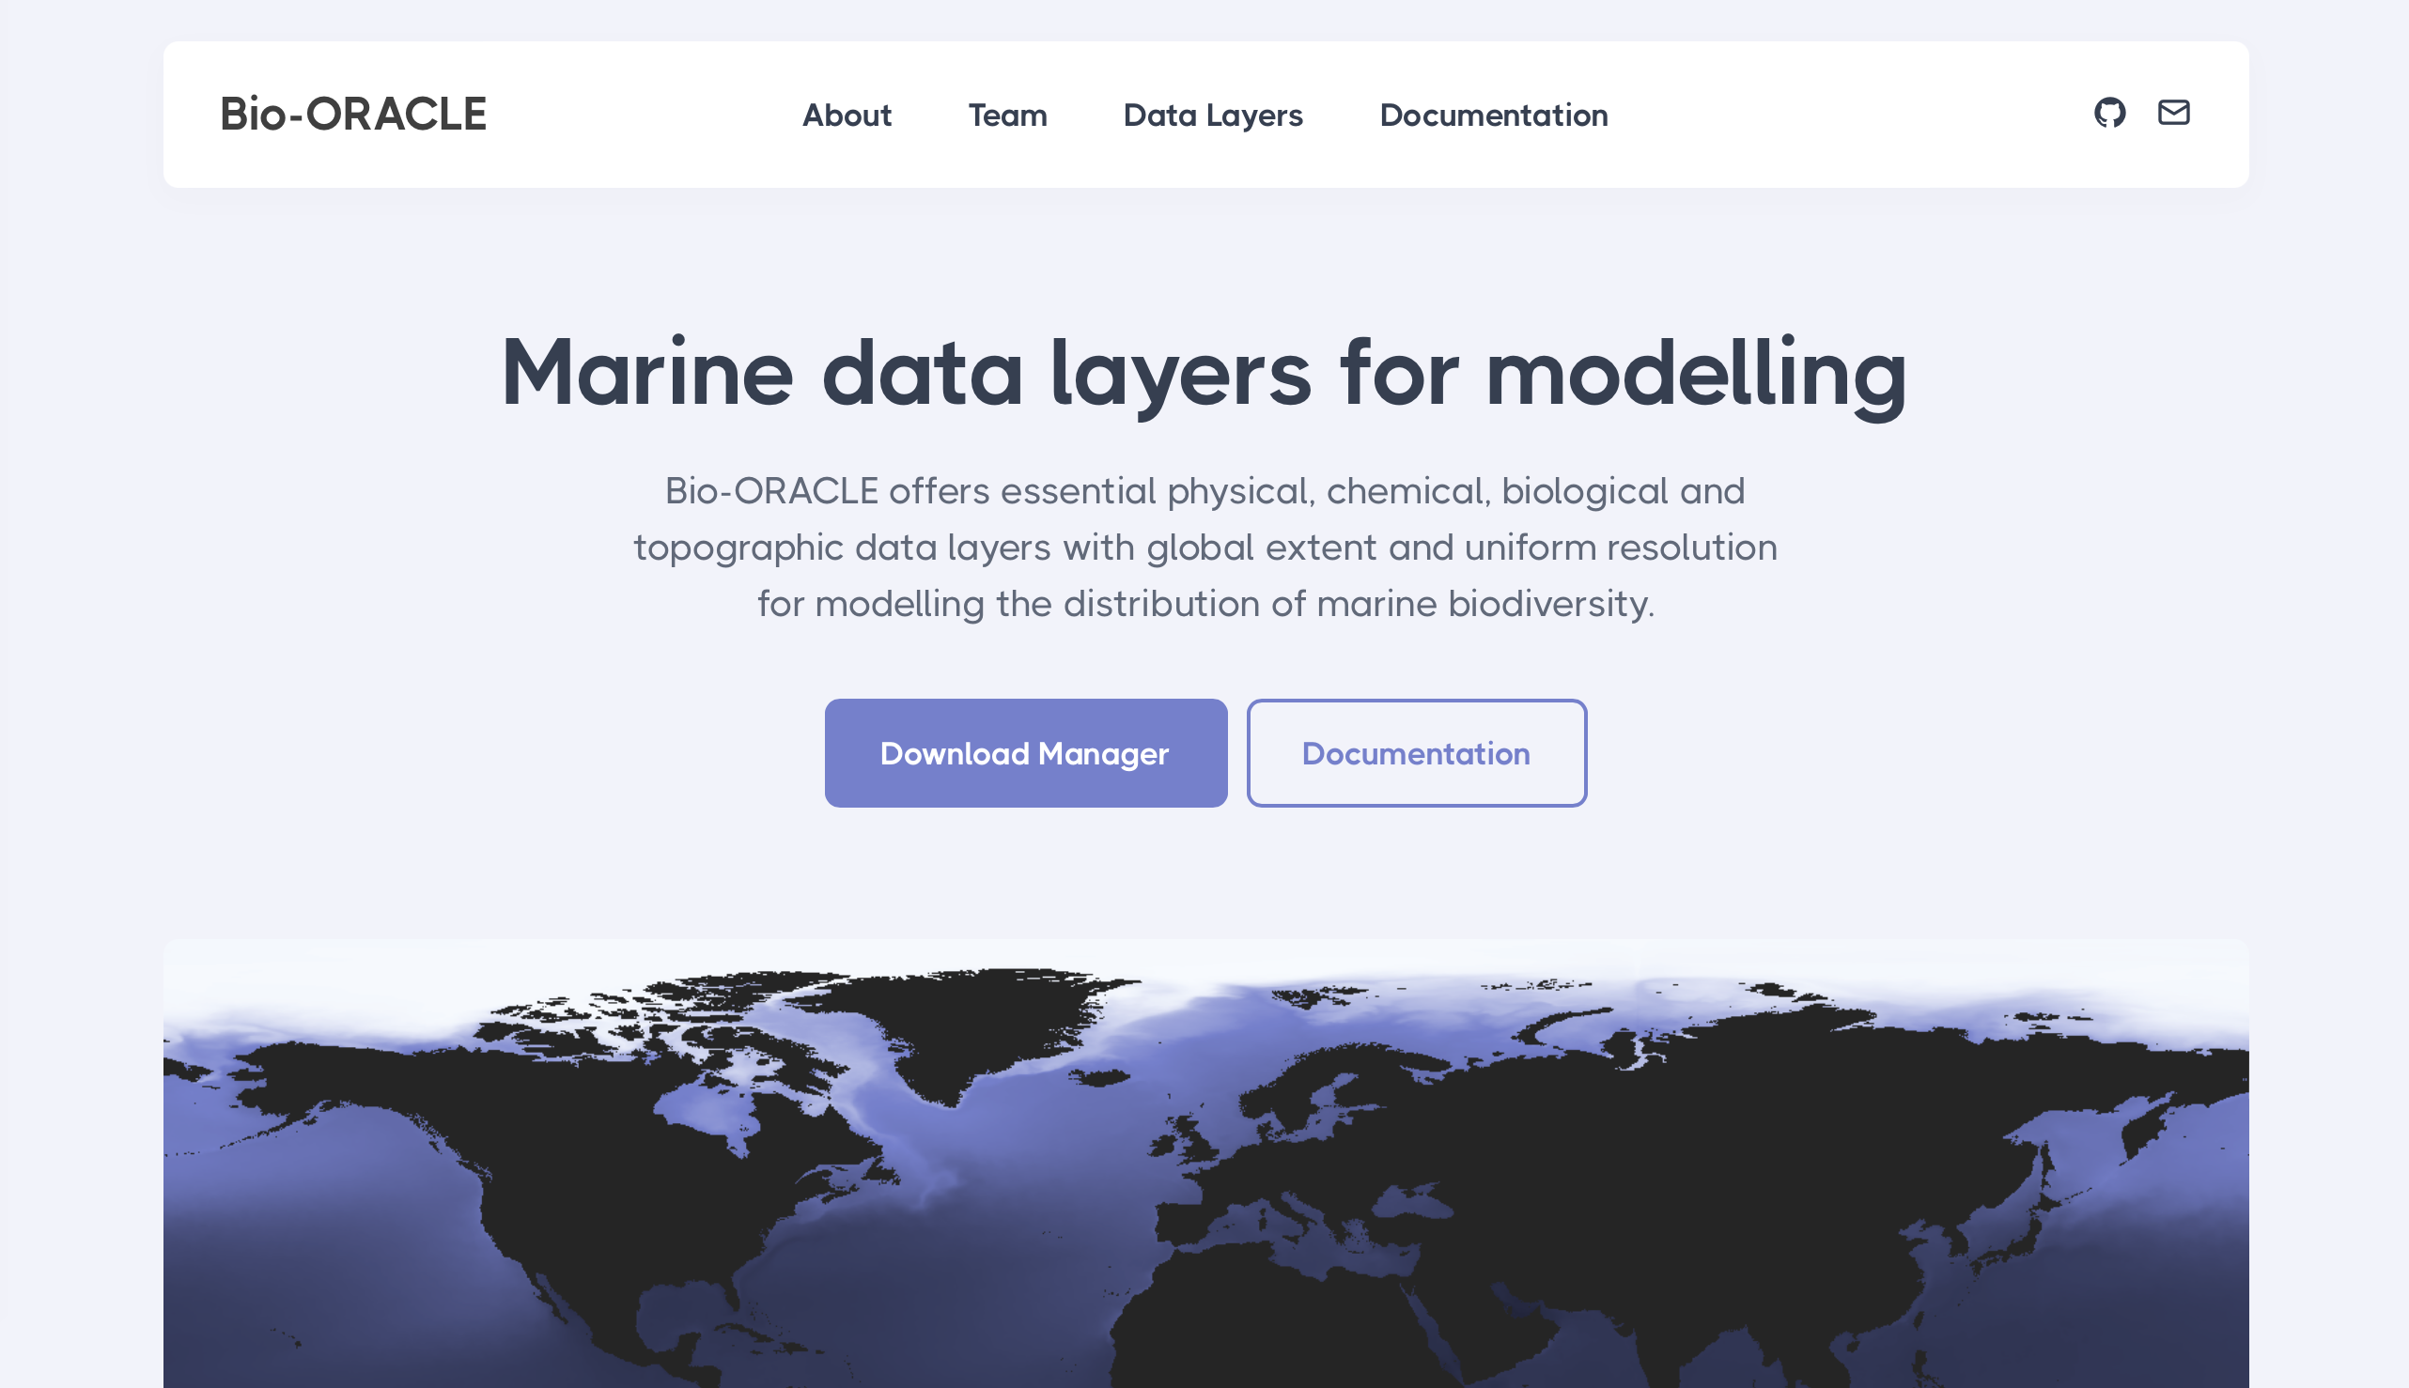
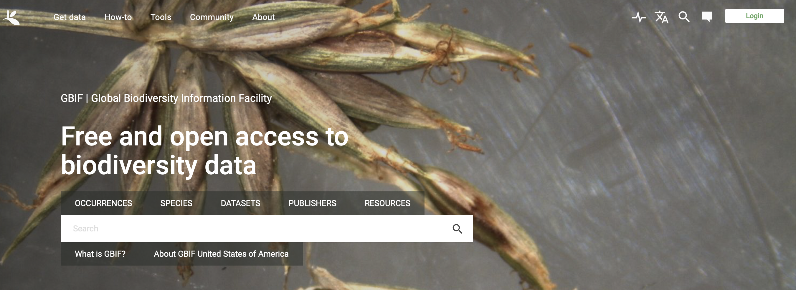
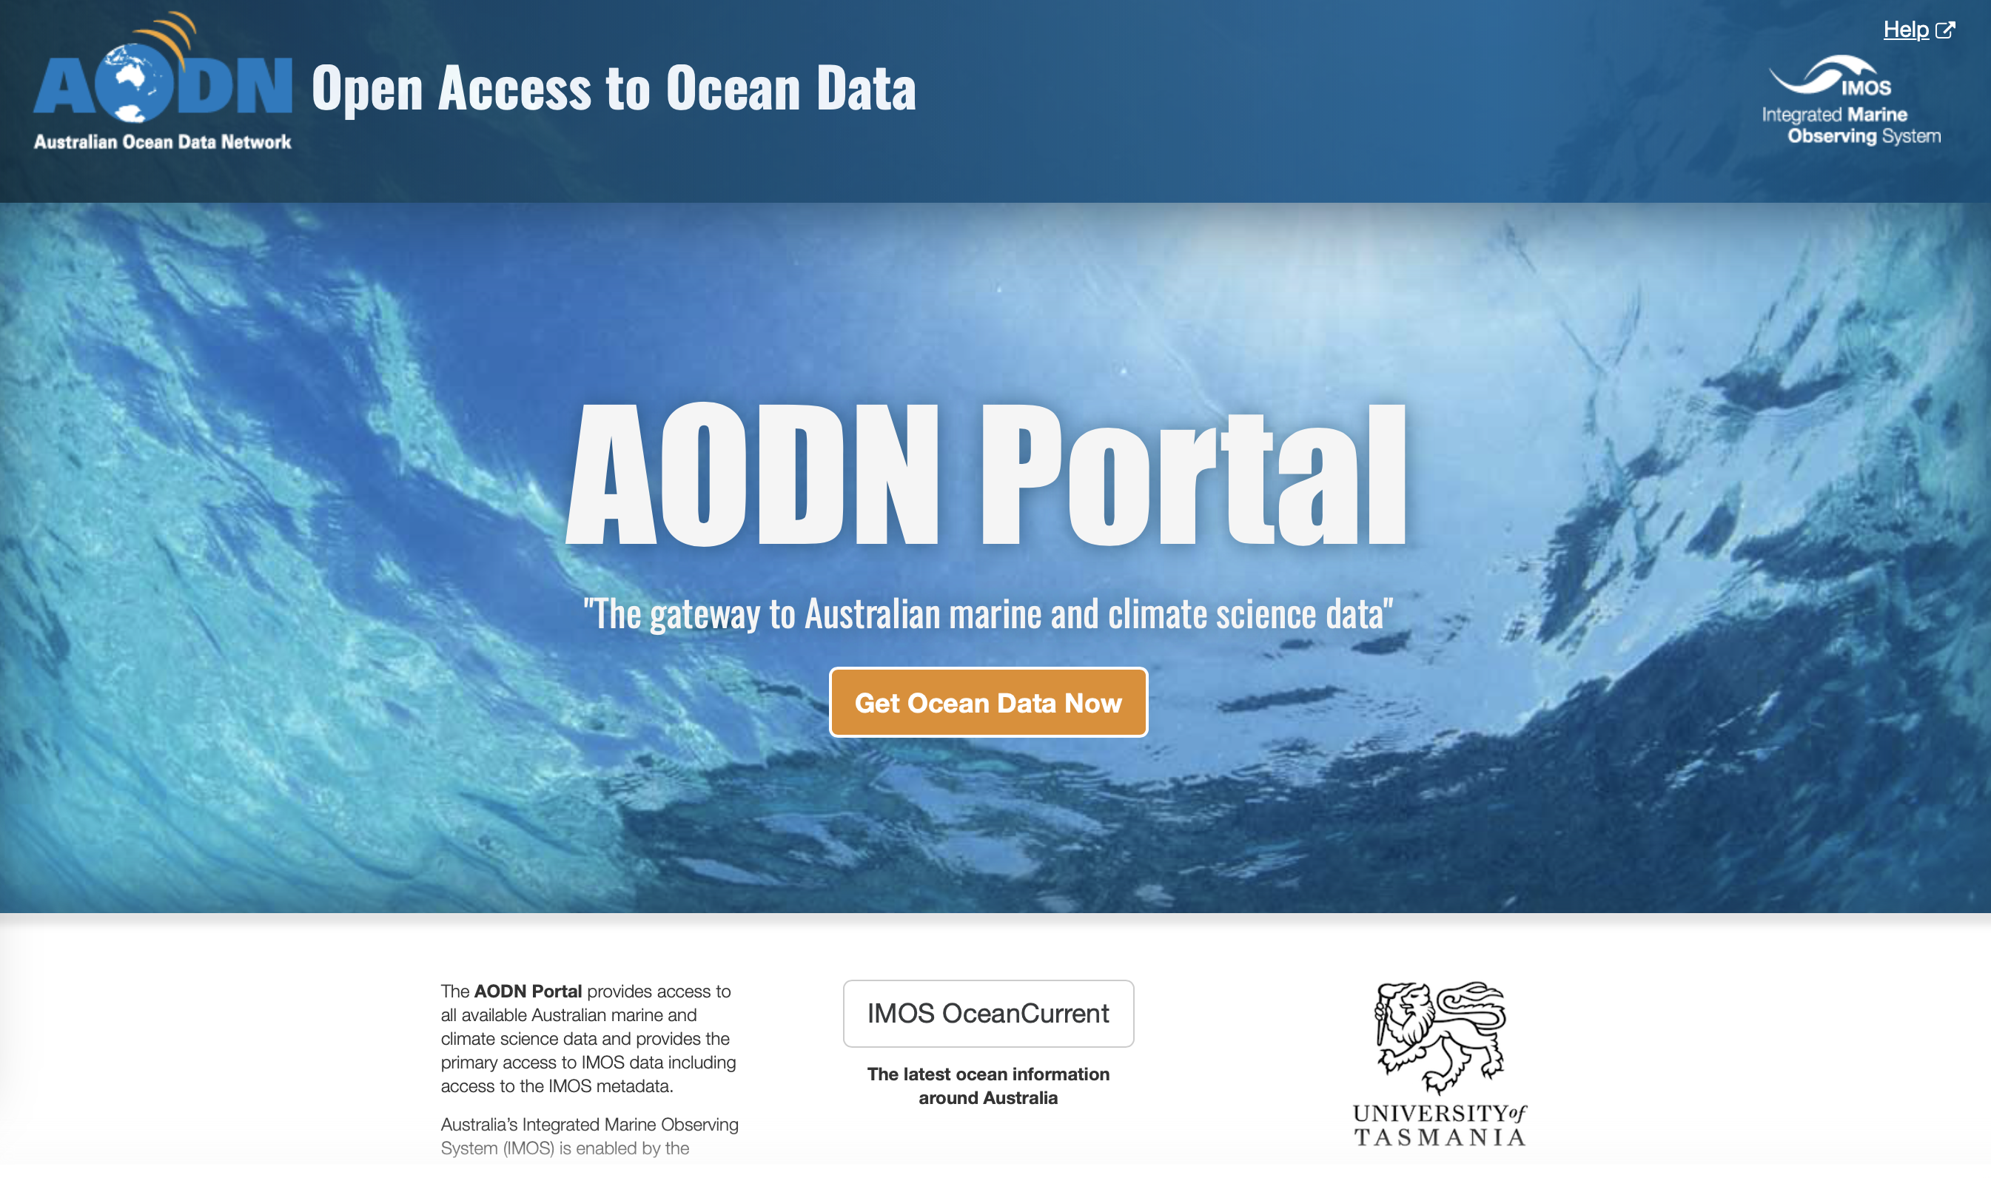
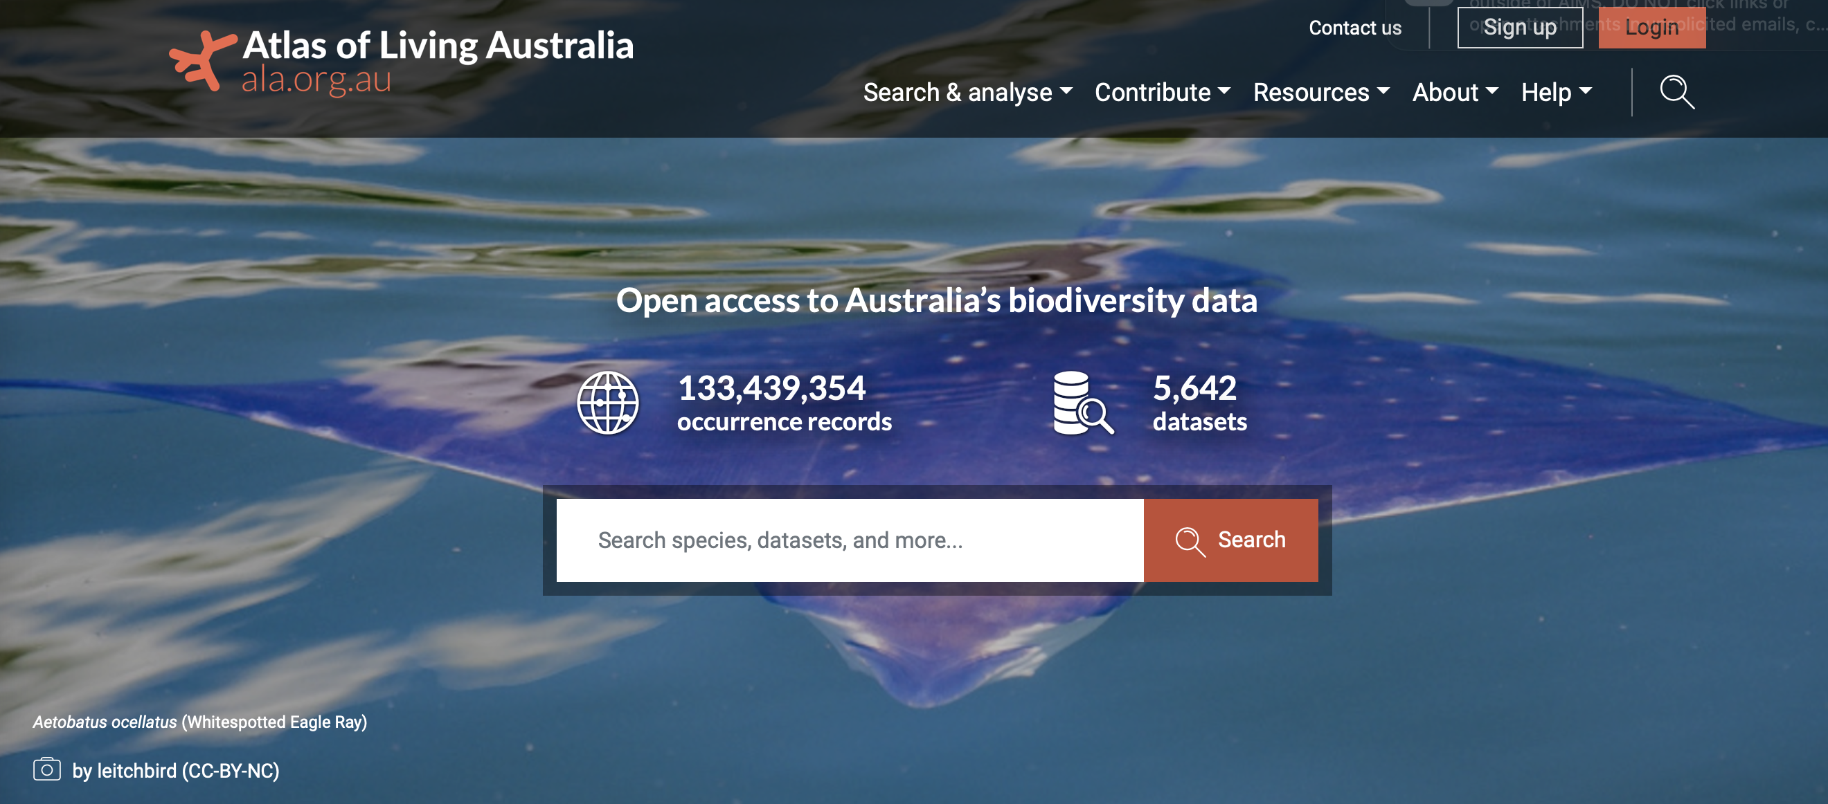
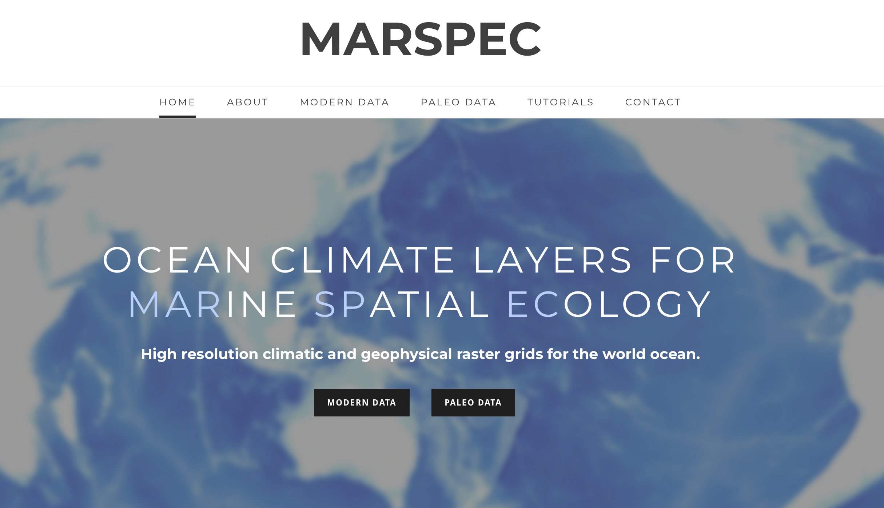
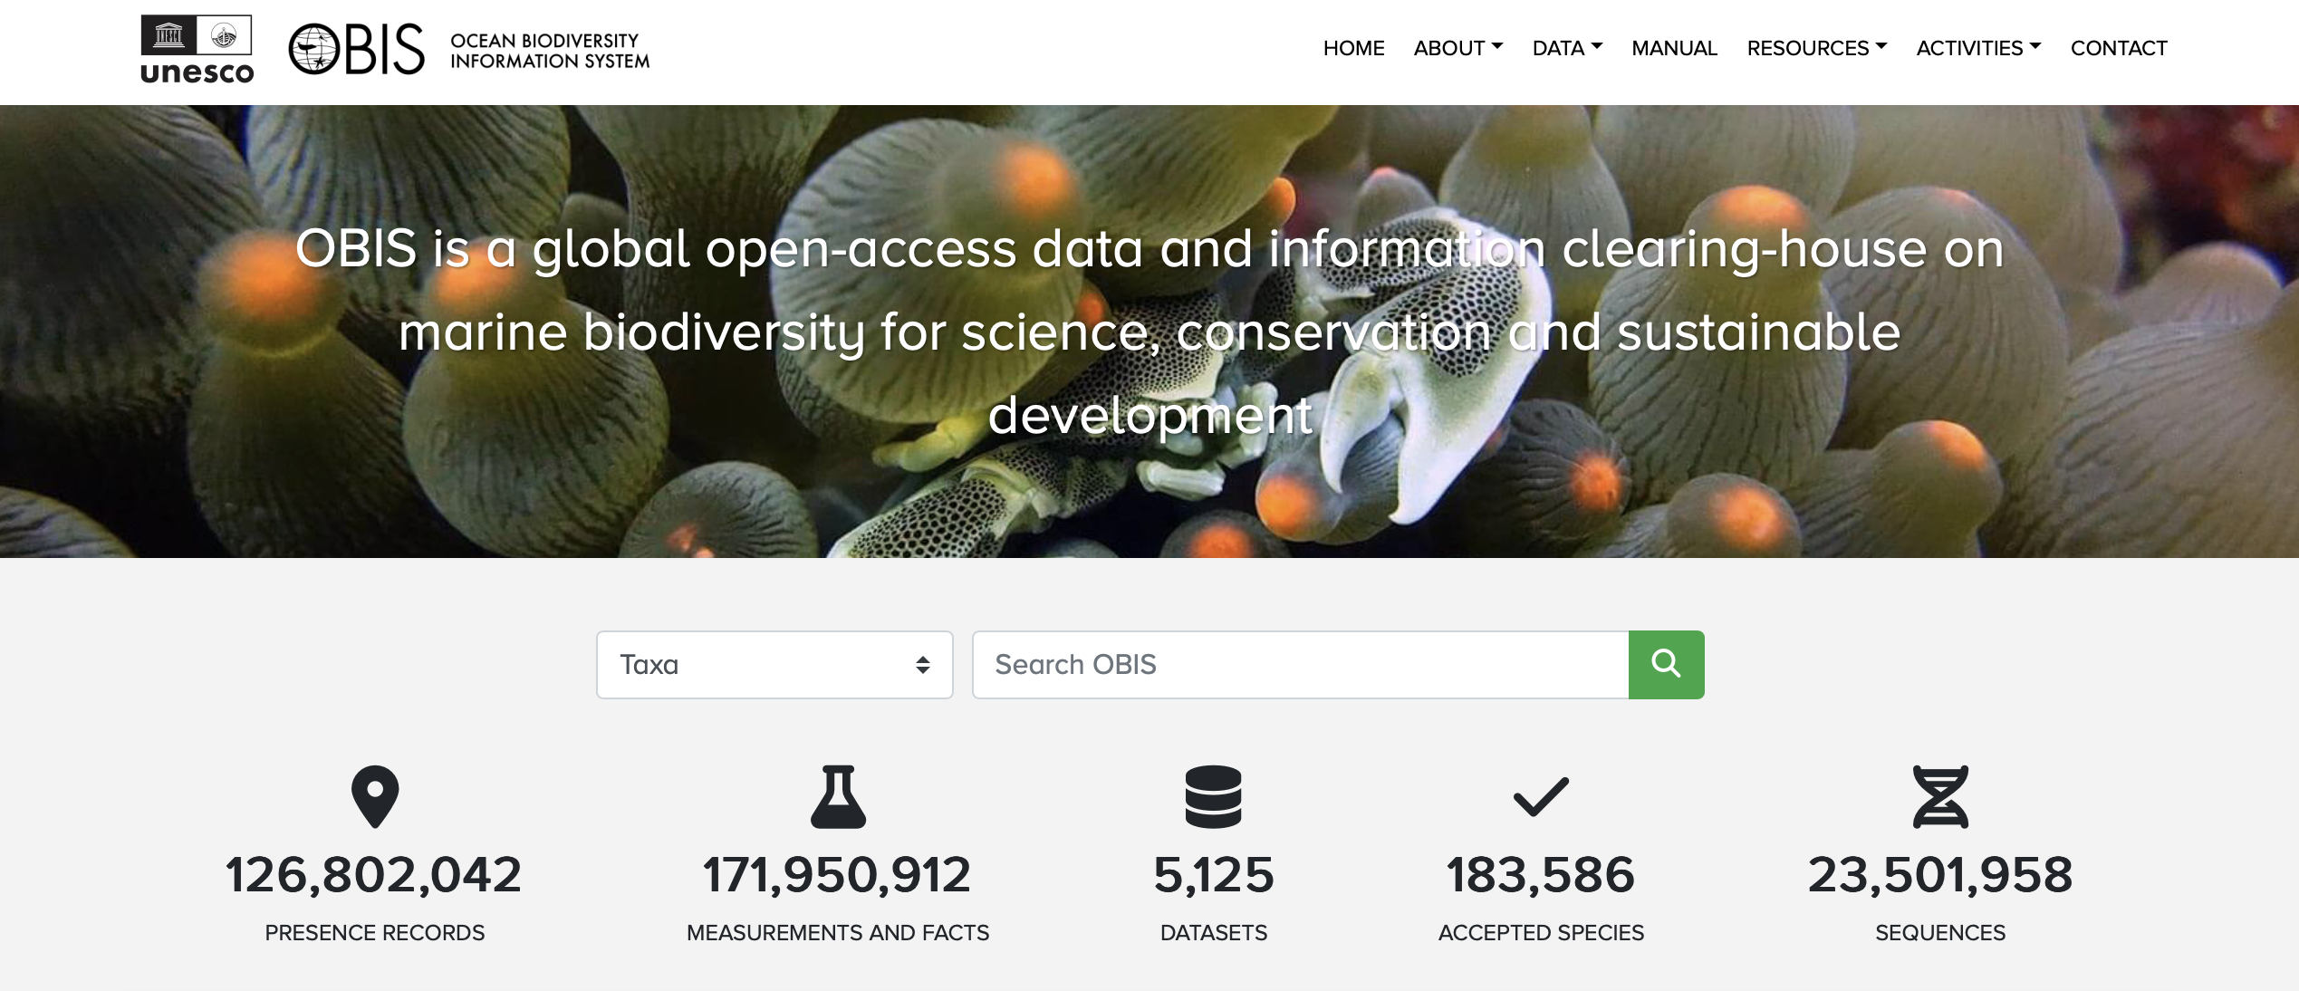
Session 3
Sources of Occurrence datasets
GBIF, ALA, OBIS
Tracking datasets
Sources of environmental datasets
Bio-Oracle
Marspec
AODN

Slide 12
Session 4

Slide 13
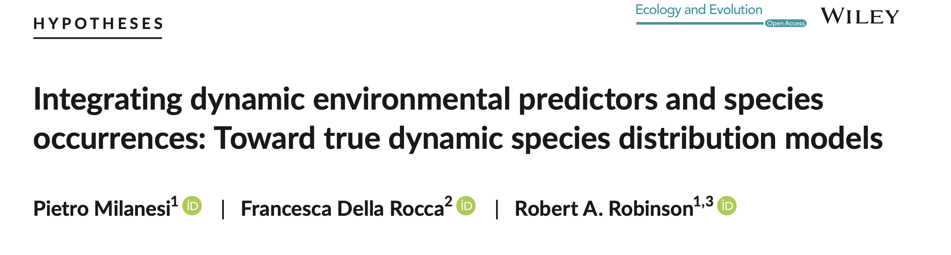
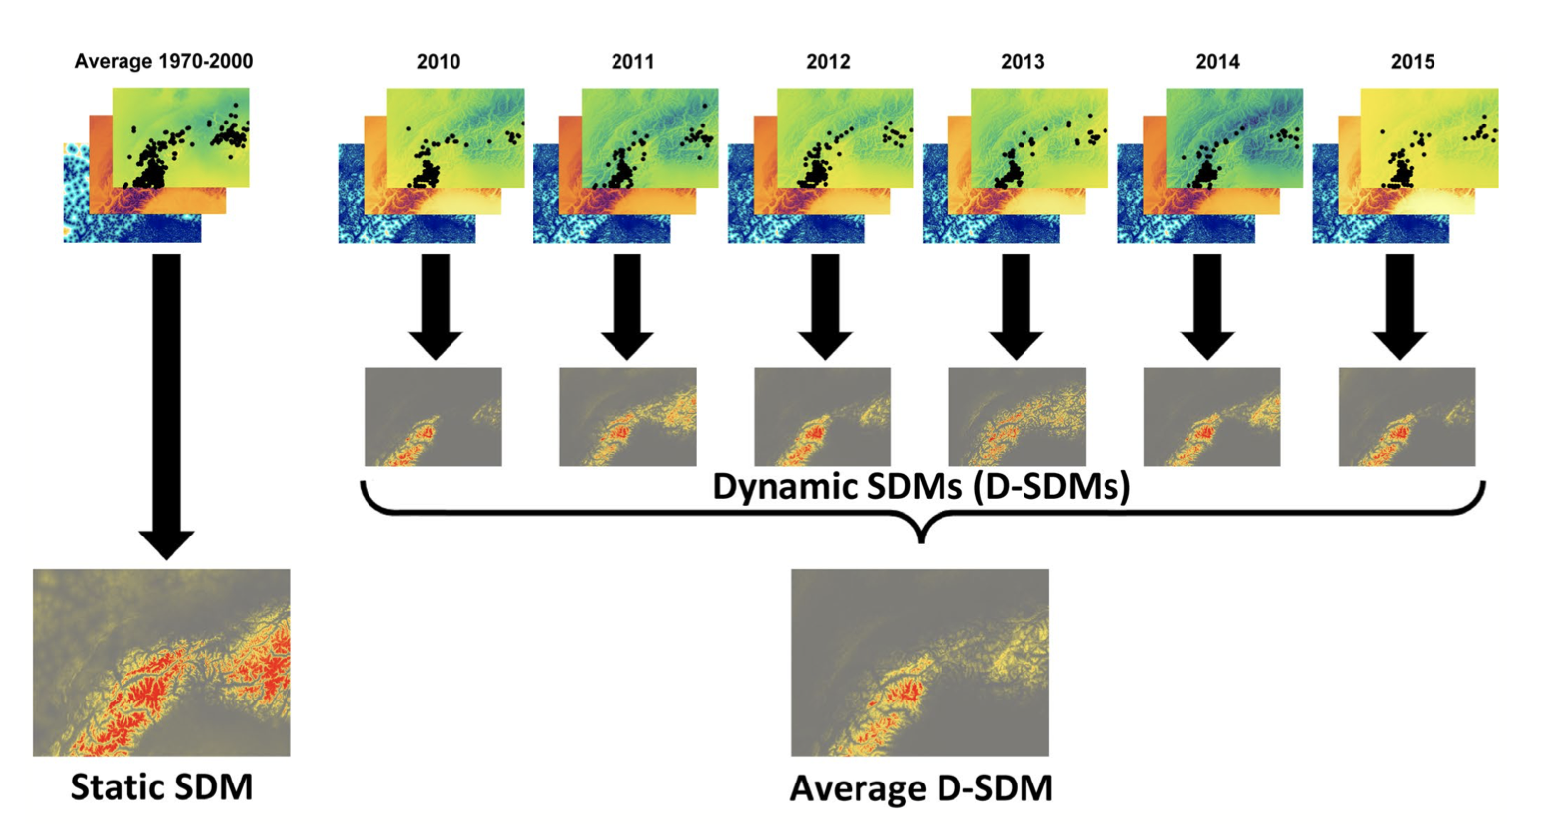
Session 4

Slide 14

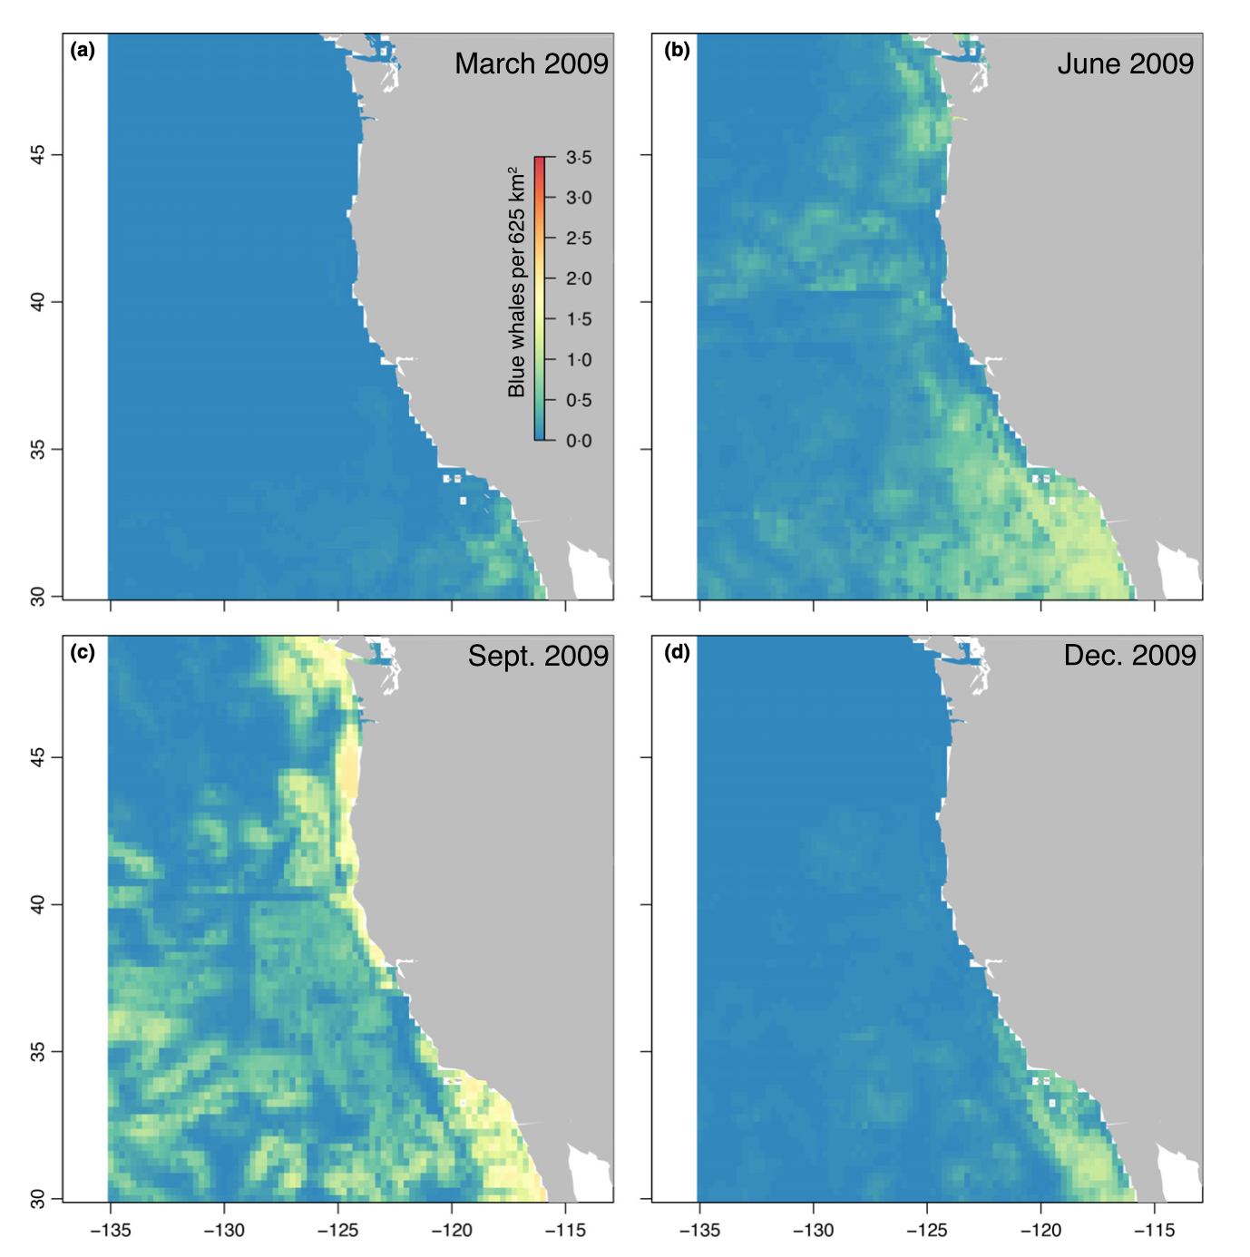
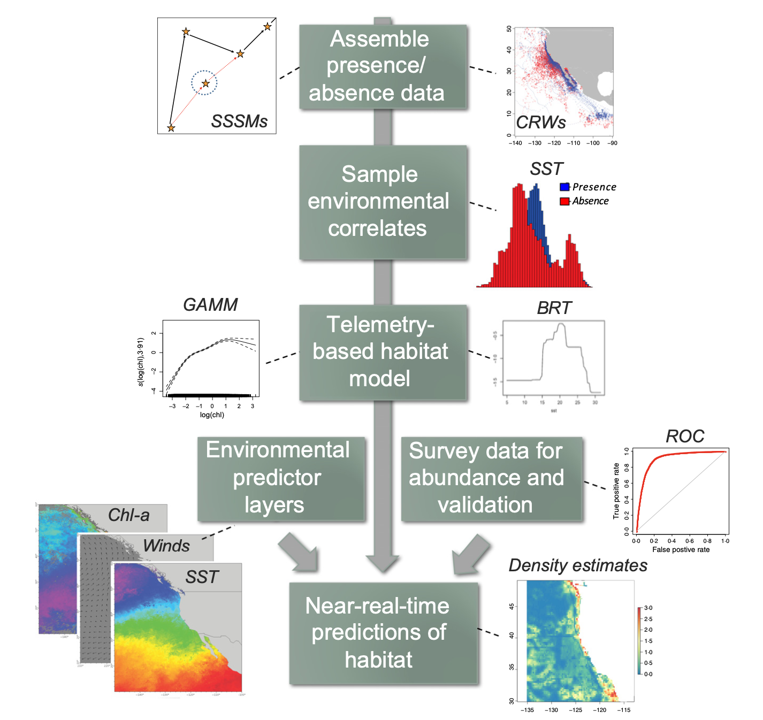
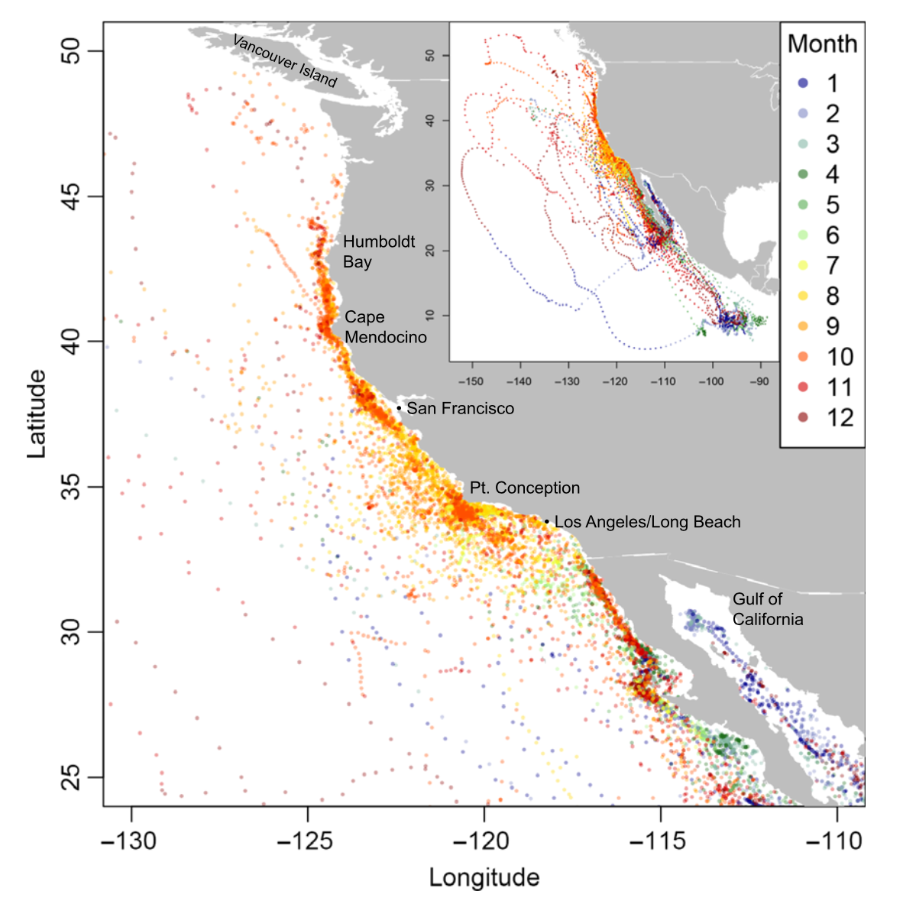
Session 4

Slide 15
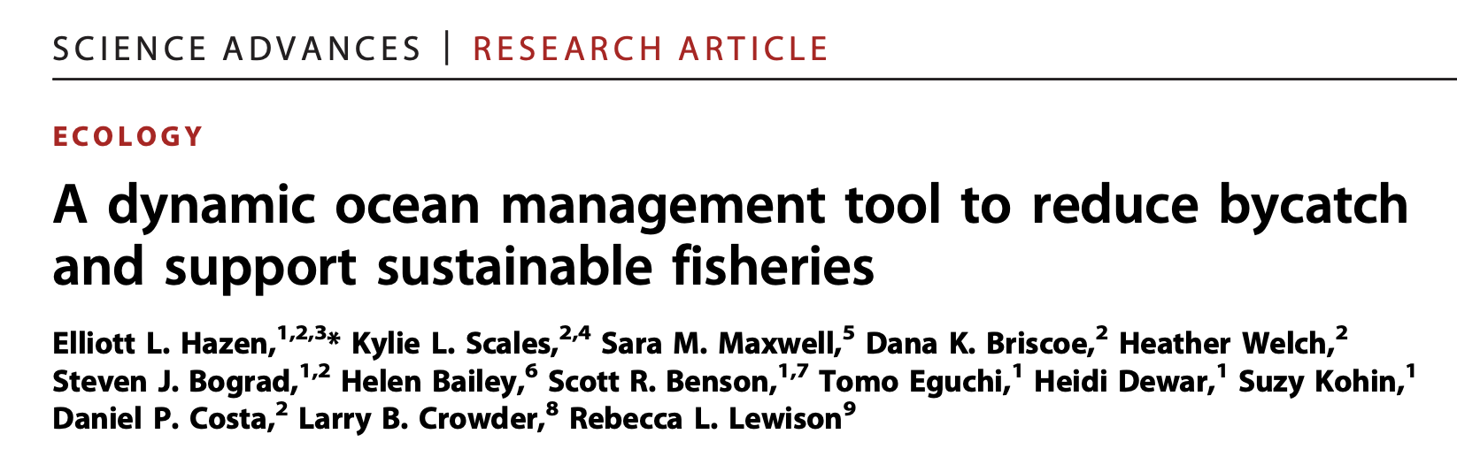
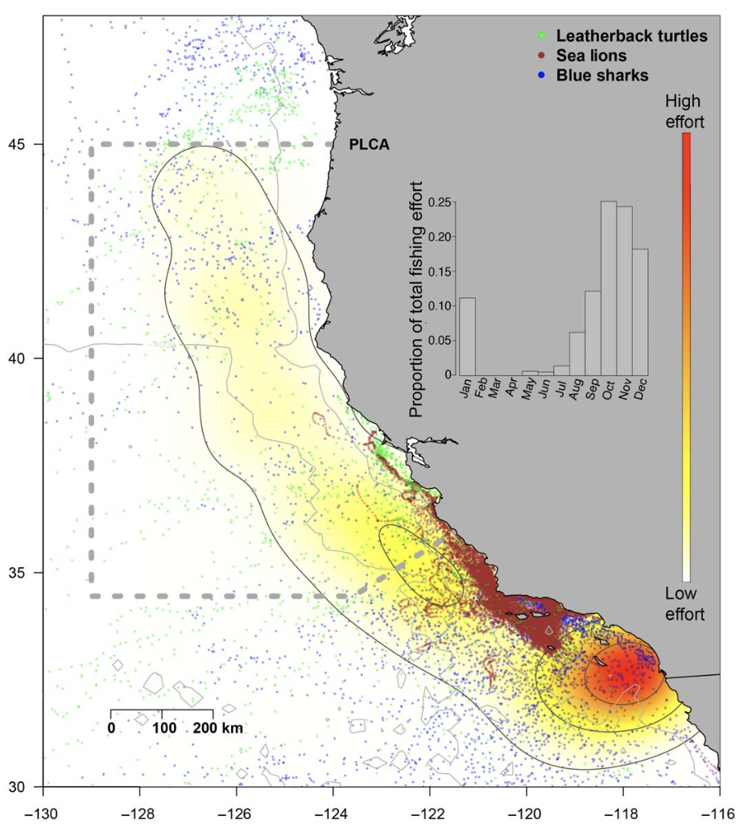
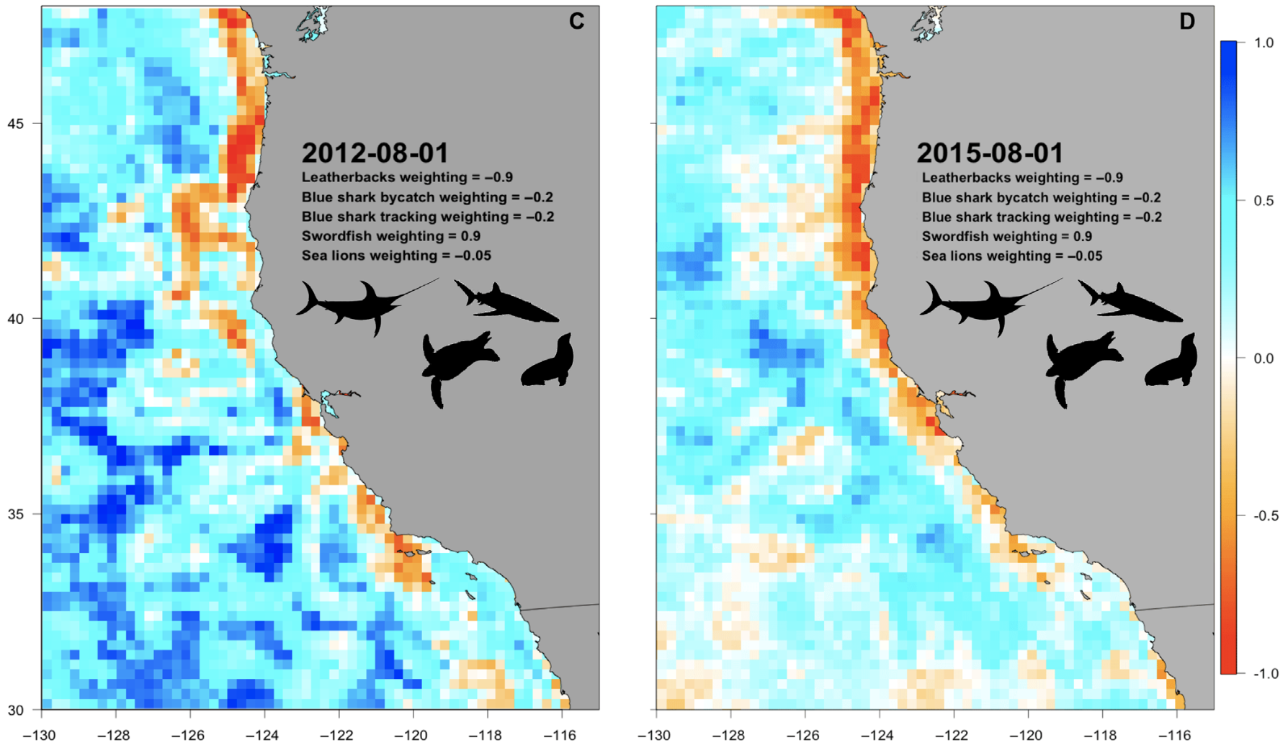
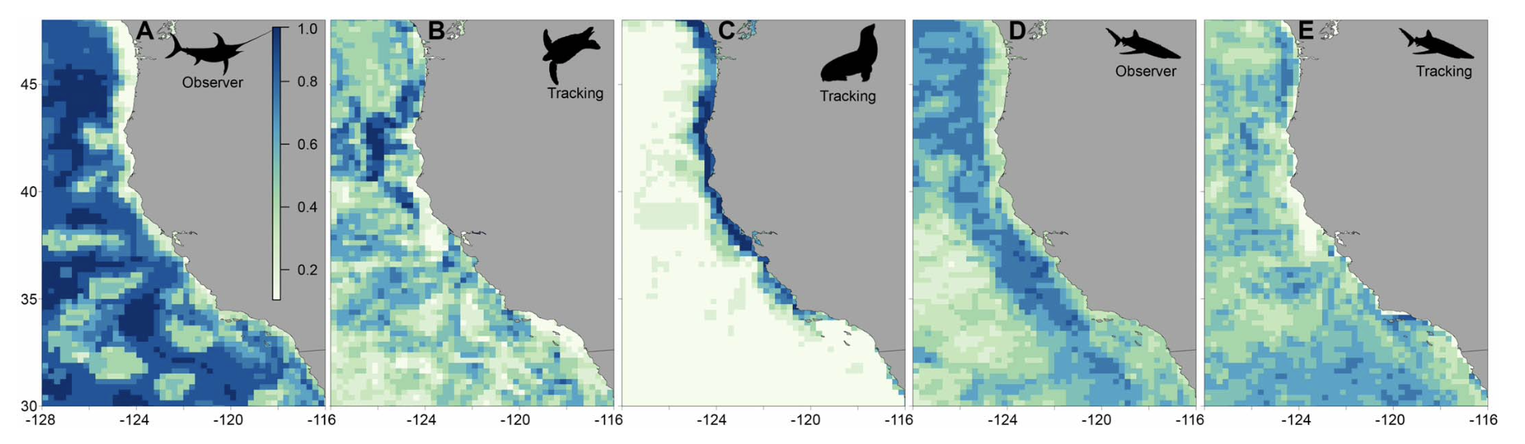
Session 4

